Slide 1

OPERATING SYSTEMS
Scheduling Algorithms
Venkatesh Prasad
Department of Computer Science

Slide 2

OPERATING SYSTEMS
Slides Credits for all PPTs of this course
The slides/diagrams in this course are an adaptation, combination, and enhancement of material from the following resources and persons:
Slides of Operating System Concepts, Abraham Silberschatz, Peter Baer Galvin, Greg Gagne - 9th edition 2013 and some slides from 10th edition 2018
Some conceptual text and diagram from Operating Systems - Internals and Design Principles, William Stallings, 9th edition 2018
Some presentation transcripts from A. Frank – P. Weisberg
Some conceptual text from Operating Systems: Three Easy Pieces, Remzi Arpaci-Dusseau, Andrea Arpaci Dusseau

Slide 3
Operating systems
Multi-level Queue & Feedback Queue Scheduling
Venkatesh Prasad
Department of Computer Science

Slide 4
OPERATING SYSTEMS
Multilevel Queue
Ready queue is partitioned into separate queues, eg:
foreground (interactive)
background (batch)
Process permanently in a given queue
Each queue has its own scheduling algorithm:
foreground – RR
background – FCFS
Scheduling must be done between the queues:
Fixed priority scheduling; (i.e., serve all from foreground then from background). Possibility of starvation.
Time slice – each queue gets a certain amount of CPU time which it can schedule amongst its processes; i.e., 80% to foreground in RR, 20% to background in FCFS

Slide 5
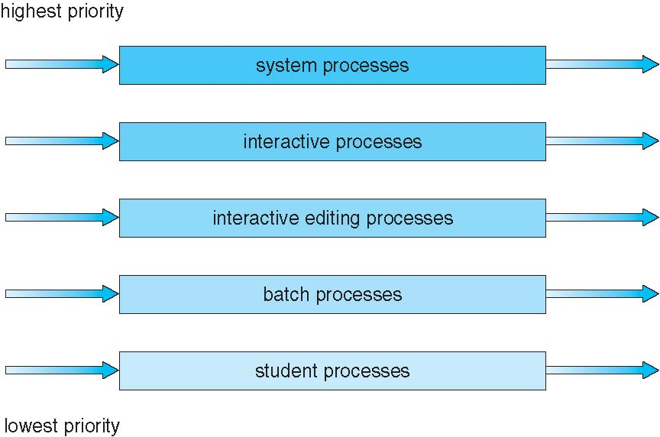
OPERATING SYSTEMS
Multilevel Queue Scheduling

Slide 6
OPERATING SYSTEMS
Multilevel Feedback Queue
A process can move between the various queues; aging can be implemented this way
Multilevel-feedback-queue scheduler defined by the following parameters:
number of queues
scheduling algorithms for each queue
method used to determine when to upgrade a process
method used to determine when to demote a process
method used to determine which queue a process will enter when that process needs service

Slide 7
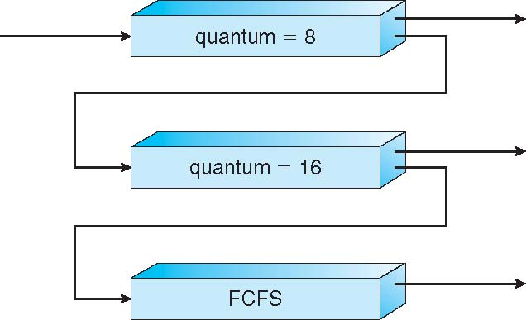
OPERATING SYSTEMS
Example of Multilevel Feedback Queue
Three queues:
Q₀ – RR with time quantum 8 milliseconds
Q₁ – RR time quantum 16 milliseconds
Q₂ – FCFS
Scheduling
A new job enters queue Q₀ which is served FCFS
When it gains CPU, job receives 8 milliseconds
If it does not finish in 8 milliseconds, job is moved to queue Q₁
At Q₁ job is again served FCFS and receives 16 additional milliseconds
If it still does not complete, it is preempted and moved to queue Q₂

Slide 8
THANK YOU
Venkatesh Prasad
Department of Computer Science Engineering
venkateshprasad@pes.edu

